Slide 1


VIRTUAL SHOP USING BOT
SHRI RAMDEOBABA COLLEGE OF ENGINEERING AND MANAGEMENT NAGPUR
TEAM ZANTAN
Made by :
Aditi Vishwakarma
Priyal Sanklecha
Tanaya Kathale
Zainab Ali
Shreyas Kothari
Yash Kothari

Slide 2
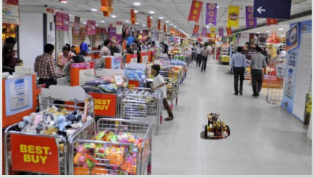
IDEA
'DIVYAANG‘(Deaf and Dumb) or be it any normal customer , when visits any retail shop , it becomes difficult for them to locate the items they require and to shop with comfort.
So, thinking for providing better service to the society ,our idea is to make a bot which shows the direction of respective products and direct the customer towards it using a mobile application.

Slide 3
SOLUTION
A user friendly mobile application which will be feasible to use for every kind of customer as well as the shopkeeper.
The app is connected to the bot .
Customer select the items, he wants to purchase from the application provided.
The bot will find the shortest optimal path for getting all the items .
Then, it will direct the customer towards the specific items one by one.
The shopkeeper will set the position of the racks in the shop through application.

Slide 4

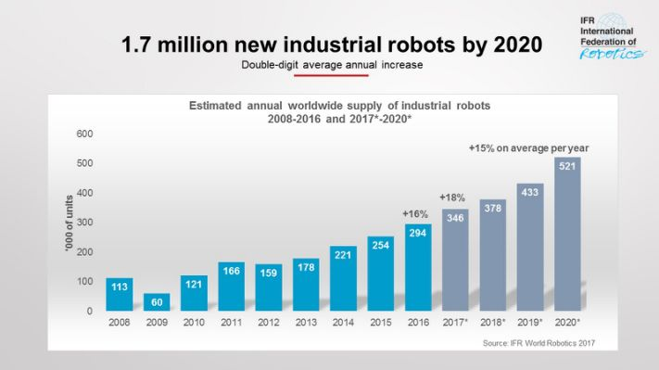
WHY BOT ?

Slide 5
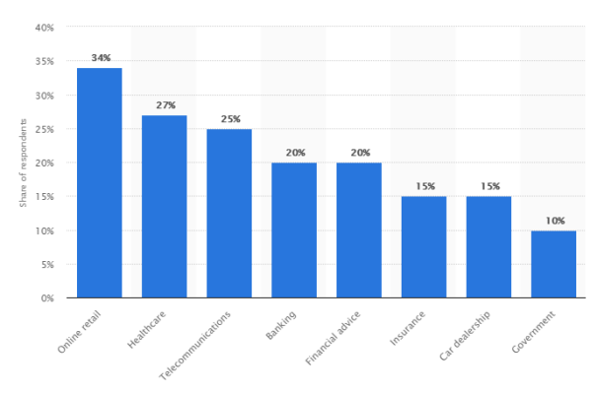

Slide 6
MOBILE APPLICATION
The app is created in Android Studio and all the information will get stored in the database provided by the Google Firebase.
ADMIN will set the dimensions of the shop and accordingly the grid will be generated.
Admin will click on the specific block and name it with a particular product.
The admin can dynamically add, remove and update the product states.
While updating, the admin can change the positions and quantities of the products.

Slide 7
1.After the CUSTOMER logs in , the list of items will get displayed.
2.He has to select between urgent or non-urgent shopping so that the bot will only get slower at the offer zone when it is non-urgent.
3.He can add and remove the items from the list dynamically.
4.He can also give voice inputs for the orders .
5. Runtime bill will be displayed on the application, as and when the products are getting added and removed.

Slide 8
BOT WORKING
The customer inputs the list of required products in the mobile application
The bot will accept the input through BLUETOOTH SENSORS.
It uses A* algorithm to find shortest optimal path from the source node and TSP to traverse , for all the products and choose the minimum distance path.
After reaching the first item, that position will become the source and the process continues until the list becomes empty.

Slide 9

The bot stops and again searches for the product having shortest optimal distance , on addition/removal of any product by the customer in between.
It detects the obstacles through sonic sensors and take the decision accordingly.

Slide 10
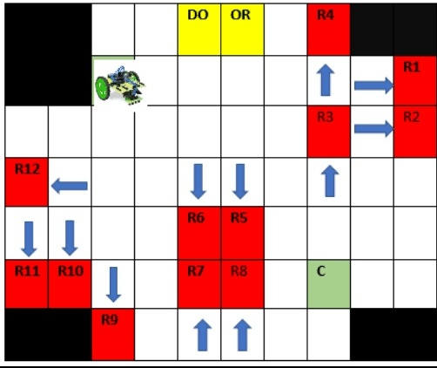
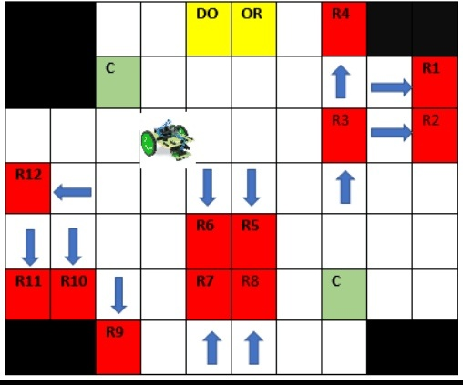
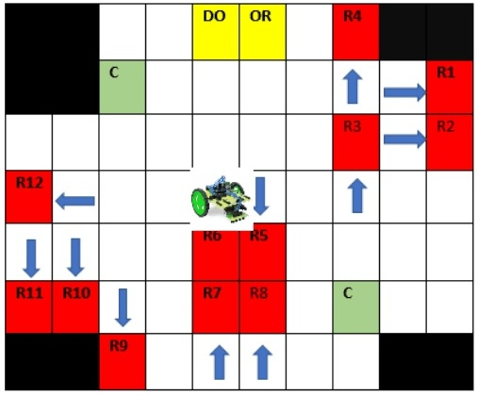
Shortest path

Slide 11
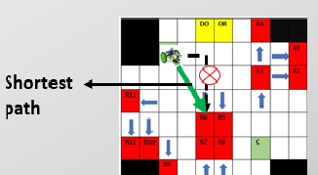
FEATURES
Dynamic modification of structure of the shop.
Calculation of shortest optimal path from each source for the nearest product.

Slide 12


The customer can add the products through voice recognition.
Runtime billing option available
Pre bot booking option for the customers.

Slide 13

Any roadblocks?
Bot movement in diagonal directions that is in north east, north west, south east and south west.
Increase in learning Arduino techniques for efficient and smooth bot turns and getting help from electronics faculty.

Slide 14

APPLICATIONS
Warehouses
Divyaang (Deaf and dumb people).
Retail
Hospitals
Hotels

Slide 15

TECHNOLOGY STACK
Arduino
Android studio
Google Firebase

Slide 16
GITHUB LINK FOR REPORT,SOURCE CODE AND VIDEO:
https://github.com/Zener786/BOTProjectTCS

Slide 17
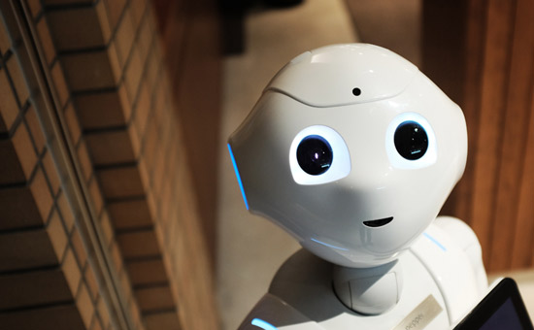
THANKYOU

